Slide 1
AIRPLANE CRASH ANALYSIS WITH POWER BI
Mentorness Project 2
Sahil Kakadiya

Slide 2
Overview
Problem Statement Project Objectives
Data Cleaning Dashboards:
Temporal Analysis
Geospatial Analysis
Trend Analysis
Conclusion
03
04
05
06
06
08
10
12

Slide 3
Problem Statement
This internship project is dedicated to a detailed examination of airplane crash incidents and related fatalities covering the period from 1980 to 2023. The dataset includes essential data points like crash dates, locations, airline operators, flight specifics, types of aircraft, and statistics on fatalities. The objective is to utilize Power BI to create interactive visualizations and provide thorough insights that reveal patterns, factors influencing these patterns, and overall trends in aviation incidents. This analysis is designed to equip stakeholders with critical information that will help improve aviation safety and reduce risks.
3

Slide 4
Project Objectives
Temporal Analysis:
Investigate time-based trends in airplane crashes across different periods.
Determine recurring patterns in the occurrence and intensity of these incidents.
Geospatial Analysis:
Display crash sites on a map to pinpoint areas with frequent incidents.
Examine how incidents are spread across various geographical locations.
Operator Performance:
Assess the safety histories of various airline operators.
Aircraft Analysis:
Investigate the role of different aircraft types in incidents.
Study the link between aircraft registration details and occurrences of crashes.
Fatality Trends:
Examine trends in fatalities among passengers and crew.
Explore the underlying factors that contribute to fatal outcomes.
Route Analysis:
Analyze patterns of incidents specific to certain flight routes.
Determine which flight paths are associated with a higher incidence of problems
4

Slide 5
Data Cleaning
The data preparation phase included rectifying missing entries, unifying data formats, and verifying data consistency and accuracy. To deepen the analytical capabilities of the dataset, three new columns were introduced: Year, Country, and City. The Year column was populated with the year extracted from the incident date. The Country column details the country of each incident, and the City column notes the cities where the incidents occurred. Additionally, aircraft lacking registration information were labeled as “No Registration.” These enhancements guarantee that the dataset is meticulously prepared for precise analysis and effective decision-making in the aviation sector.
5

Slide 6
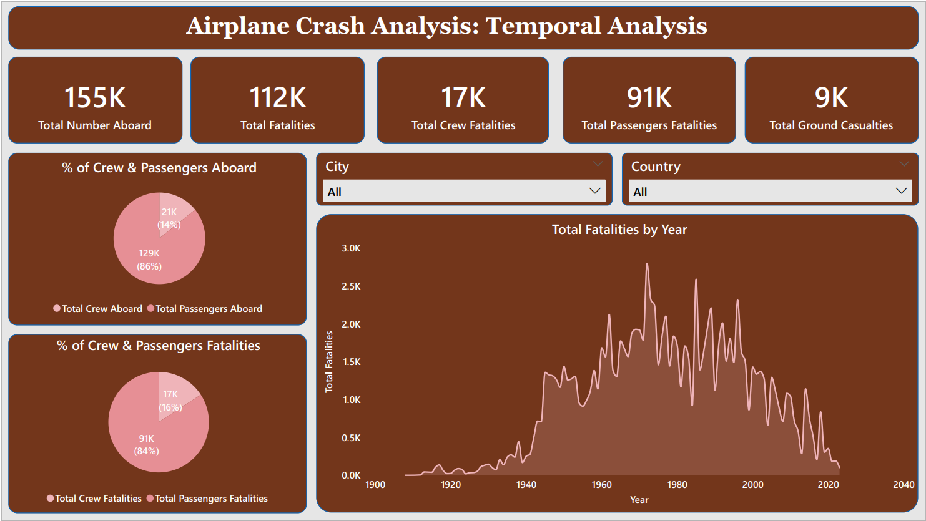

Slide 7
The temporal analysis highlighted variations in the frequency of airplane crashes over the years, with significant peaks and troughs noted. Specifically, the year 1972 saw the highest number of fatalities, totaling 2,796, while the years 1908 and 1909 recorded the lowest number of fatalities at just 1 each. Additionally, the analysis uncovered the composition of those aboard the aircraft, with crew members constituting 14% and passengers making up 84%.
Further insights were gained regarding the fatalities, revealing that 16% were crew members and 84% were passengers. This breakdown provides a more nuanced understanding of how fatalities are distributed among those on board.
7

Slide 8
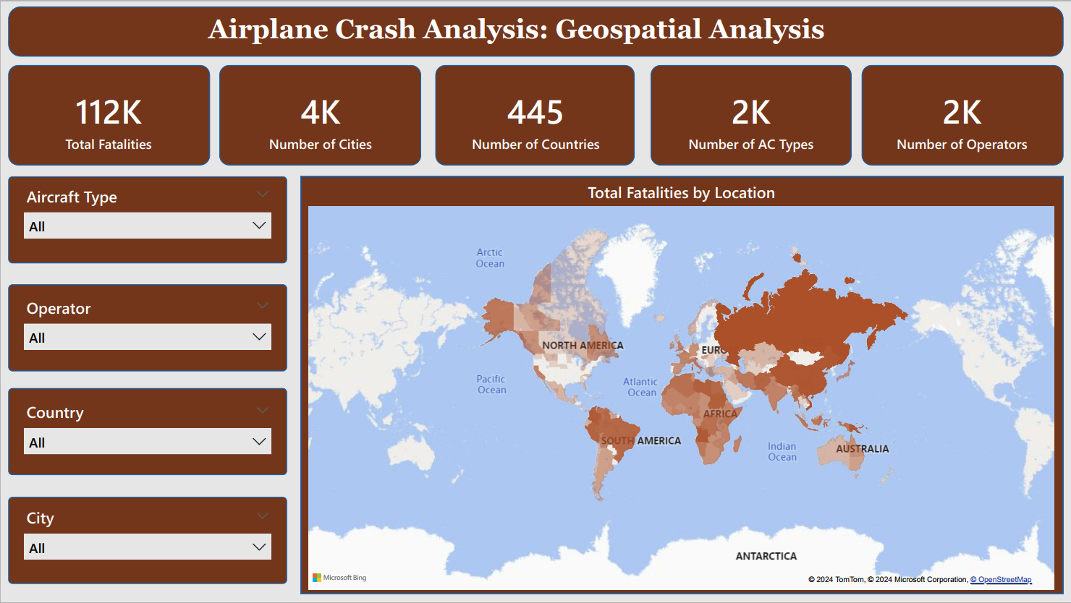

Slide 9
The visualization of crash locations on a world map has pinpointed regions with higher concentrations of incidents, highlighting these areas as hotspots. This information is crucial for stakeholders, enabling them to direct their resources and safety measures to regions with elevated incident rates.
Utilizing Power BI's interactive tools further enhances this analysis, allowing for the identification of specific aircraft types and operators associated with the highest number of incidents in these key locations. This capability provides stakeholders with detailed insights that can guide targeted improvements in aviation safety.
9

Slide 10
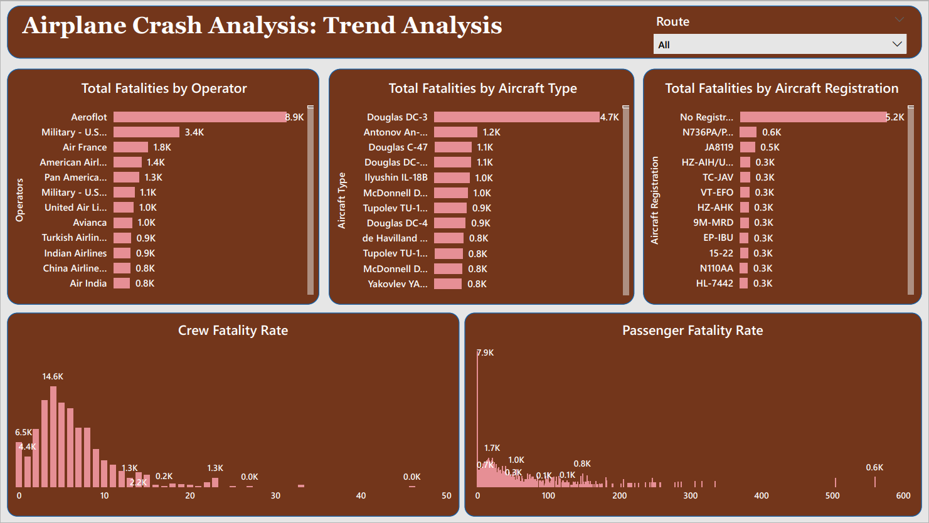

Slide 11
Flight routes analysis revealed insights into routes with a higher likelihood of incidents. This will help stakeholders make informed decisions regarding route planning.
By analyzing the total fatality by operator and aircraft type, operators and aircraft types with the highest record of fatalities were identified.
Exploring the trends in passenger and crew fatalities revealed the rate of crew and passenger fatality. This gives stakeholders insight into fatality distribution for each incident helping in deriving safety measures to combat it.
11

Slide 12
Conclusion
The extensive analysis of airplane crash data spanning from 1980 to 2023 has yielded critical insights into the dynamics, contributing factors, and trends of aviation incidents. Leveraging Power BI for interactive visualizations and detailed exploration of the data has brought to light significant findings. These findings illuminate historical patterns and provide stakeholders with actionable information that can be used to enhance aviation safety and effectively mitigate risks. By comprehensively understanding the nature of past incidents, stakeholders are equipped to make well-informed decisions aimed at enhancing safety protocols, refining operational procedures, and strengthening regulatory measures.
12

Slide 13

Thank You!

